Slide 1
Arduino basics Bill Pence KI4US
Arduino environment provides many libraries and examples to quickly begin a project

Slide 2
Arduino examples
There are Arduino examples to be found for many projects such as
SWR bridge
https://duino4projects.com/arduino-rf-power-swr-meter/
CW Keyer
https://blog.radioartisan.com/arduino-cw-keyer/
Rotor Controller (with serial interface)
https://blog.radioartisan.com/arduino_rotator_controller/

Slide 3
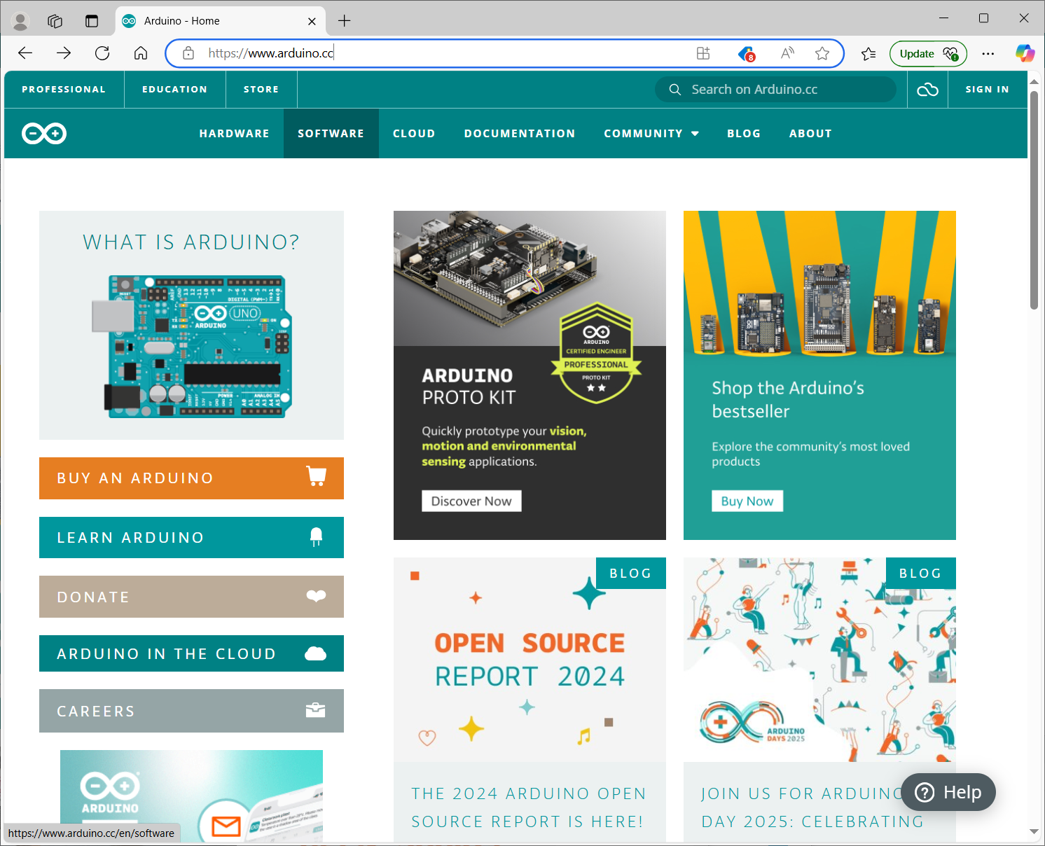
Start at https://arduino.cc where the integrated development environment (IDE) can be downloaded.
Click the “software tab”

Slide 4
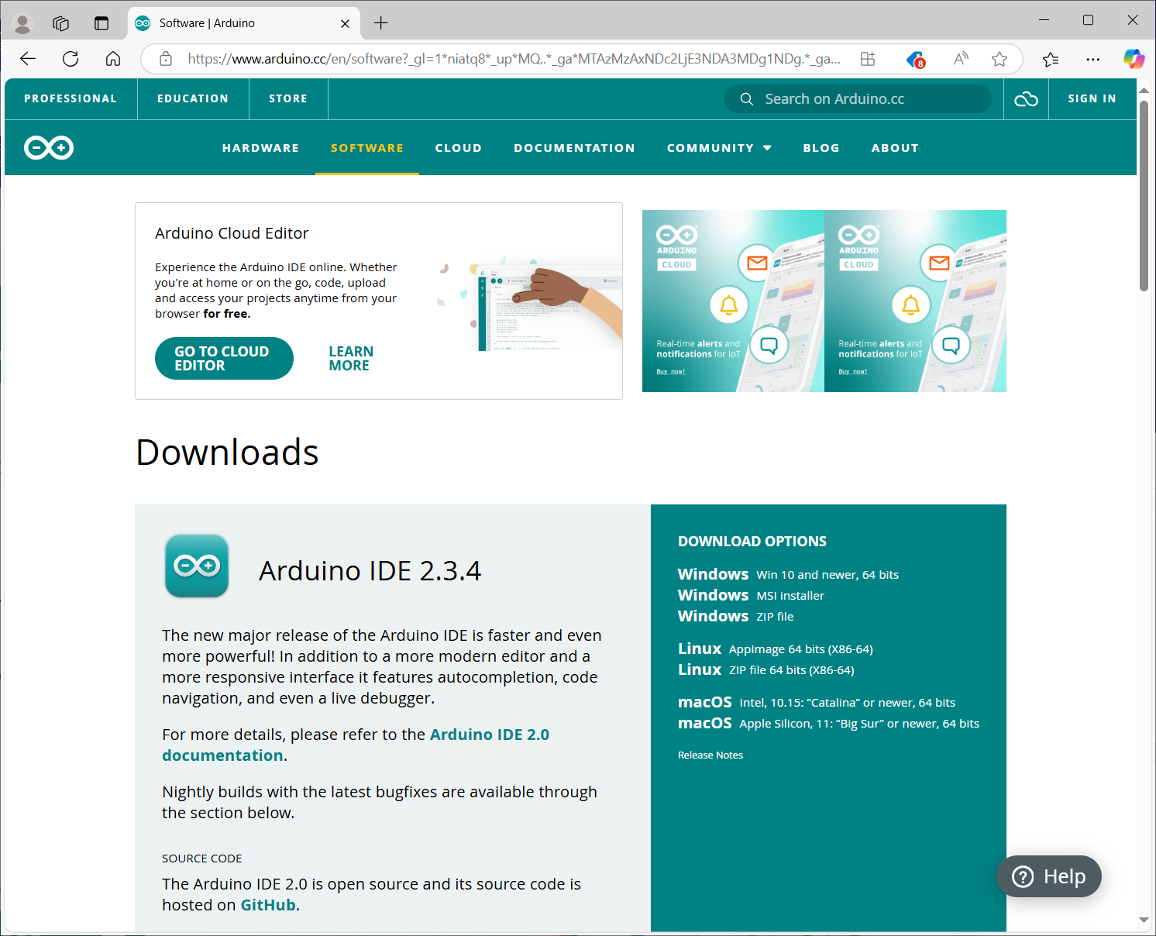
Choose the IDE version for your computer. I suggest the first option if you are a windows user.

Slide 5
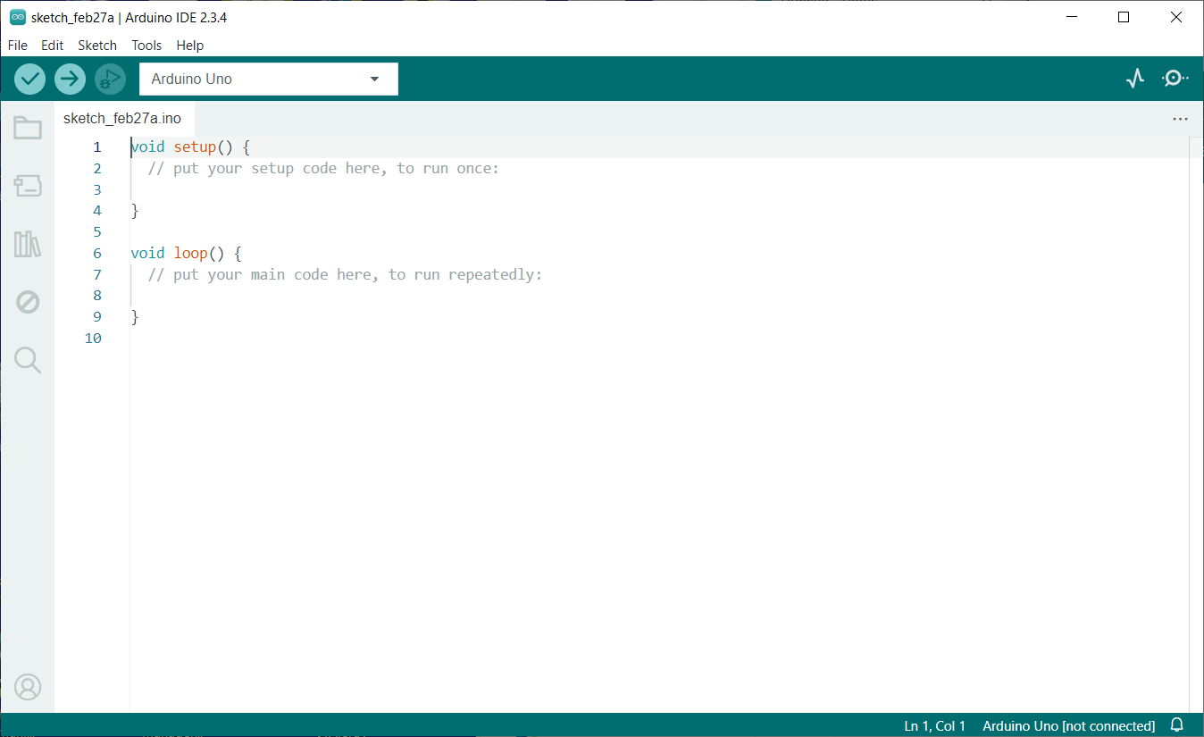
After download and install, run the Arduino IDE.
This should have a window like this with a basic “sketch” (this is what Arduino calls a program)
Note the “books” icon left of the code window.

Slide 6
Libraries
The “books” icon on the left toolbar opens the library manager.
The “sketch” has 2 basic elements.
setup() --- this part of the code runs 1 time.
loop() --- this part of the code runs forever
Each library will include example sketch
Using an example as a project base helps to get started
Combining examples from libraries synthesizes a project
Once basics are in place, algorithms can be added and optimized

Slide 7
Let’s do an example of a sketch that will read a temperature and humidity sensor and provide serial output of that data to the Arduino serial port, then an I2C LCD showing the data will be added.

Slide 8
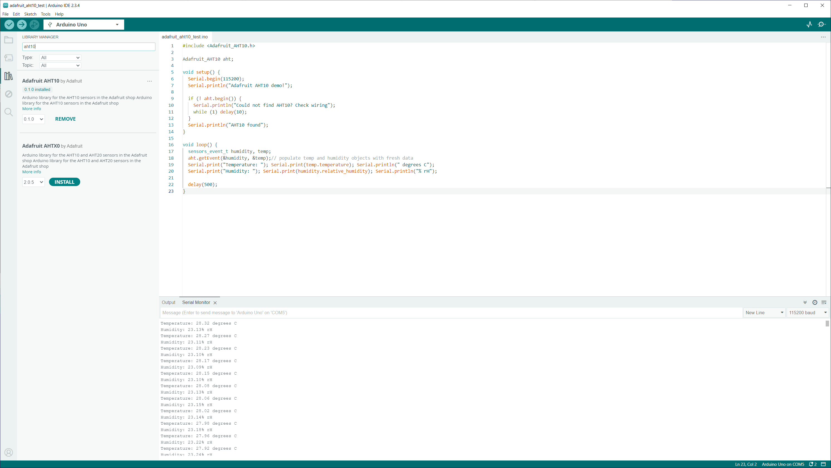
Start with the FILE menu and select New Sketch.
Then click the “books” icon or select menu TOOLS →
Manage Libraries
We are using an AHT10, and I2C LCD
Search for AHT10 and install the Adafruit AHT10 library

Slide 9
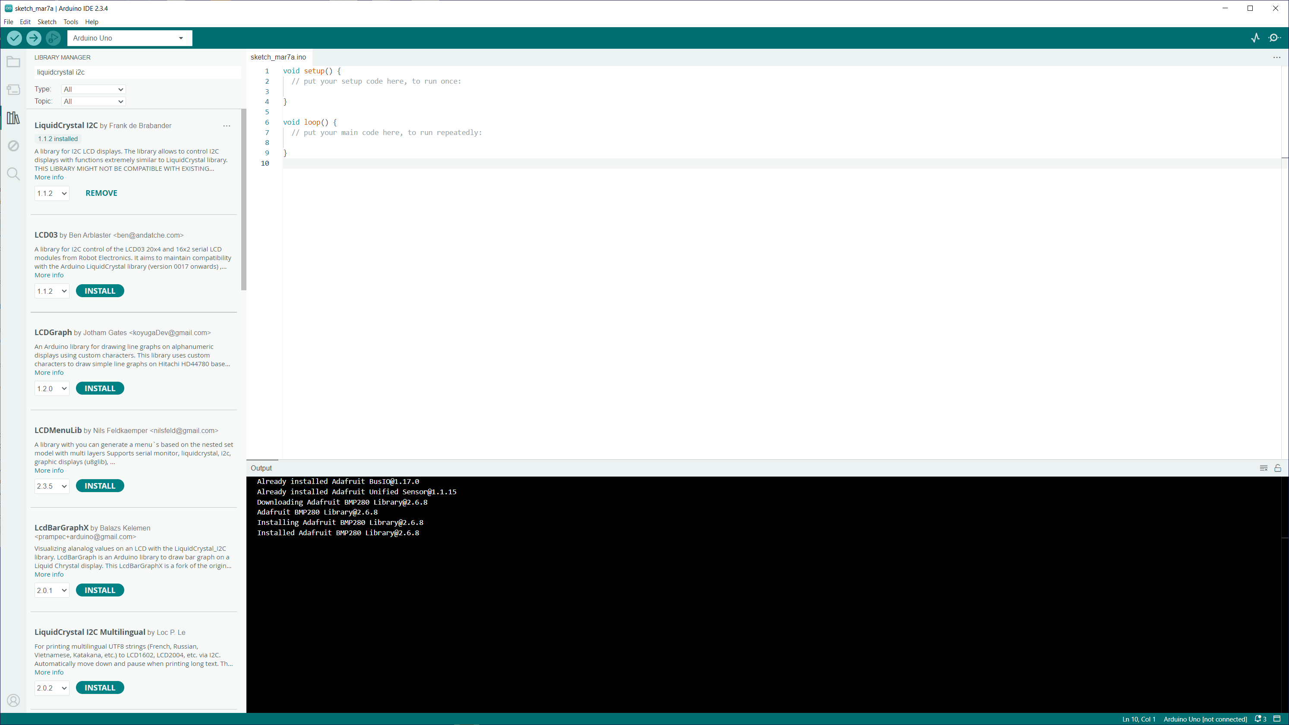
Then finally search for LiquidCrystal I2C and install this library as well.

Slide 10
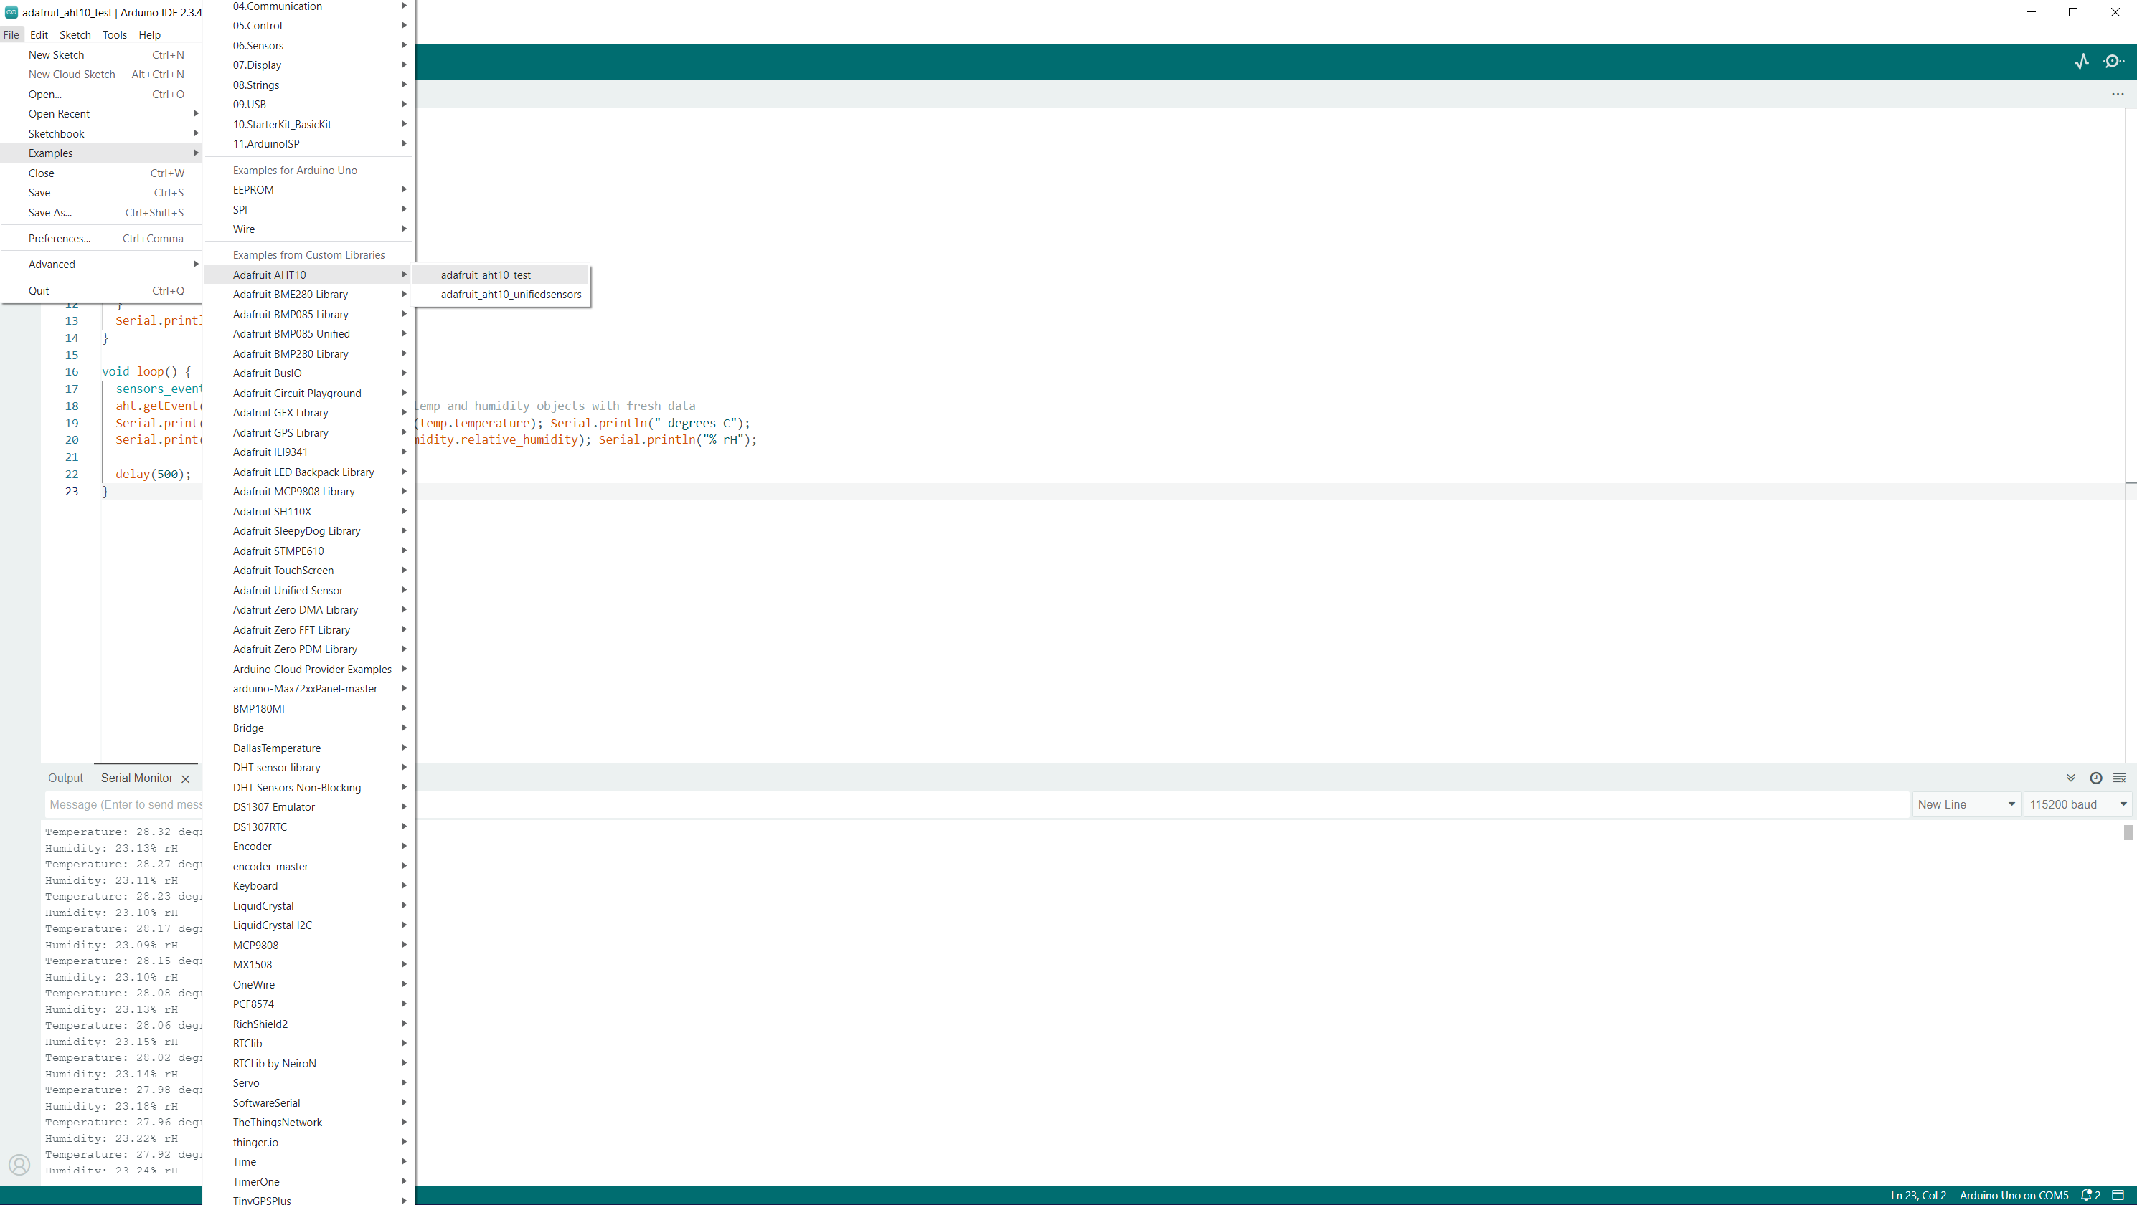
Now, let’s start.
Select menu File -> Examples ->
Adafruit AHT10 →
adafruit_aht10_test
This will open a new sketch window

Slide 11
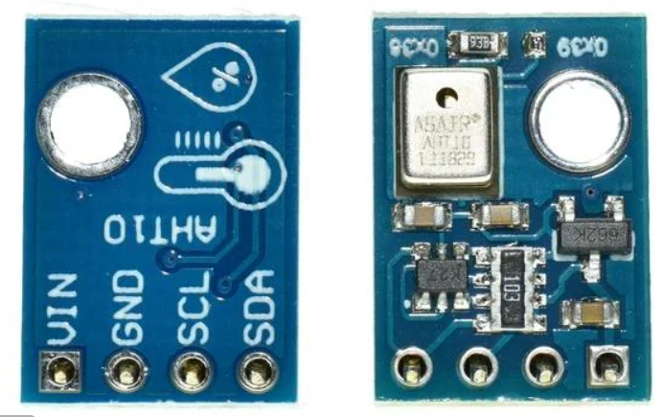
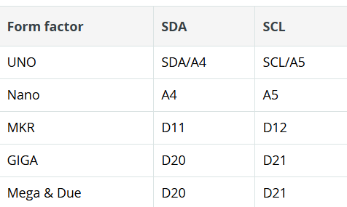
AHT10 wiring requires the
VIN, GND, SCL and SDA.
(VIN is 5VDC for this module)
Wire the I2C and power pins to the Arduino.
The I2C pins can change based on the Arduino in use.
https://docs.arduino.cc/learn/communication/wire/
So be sure to use the correct SDA and
SCL pins.

Slide 12
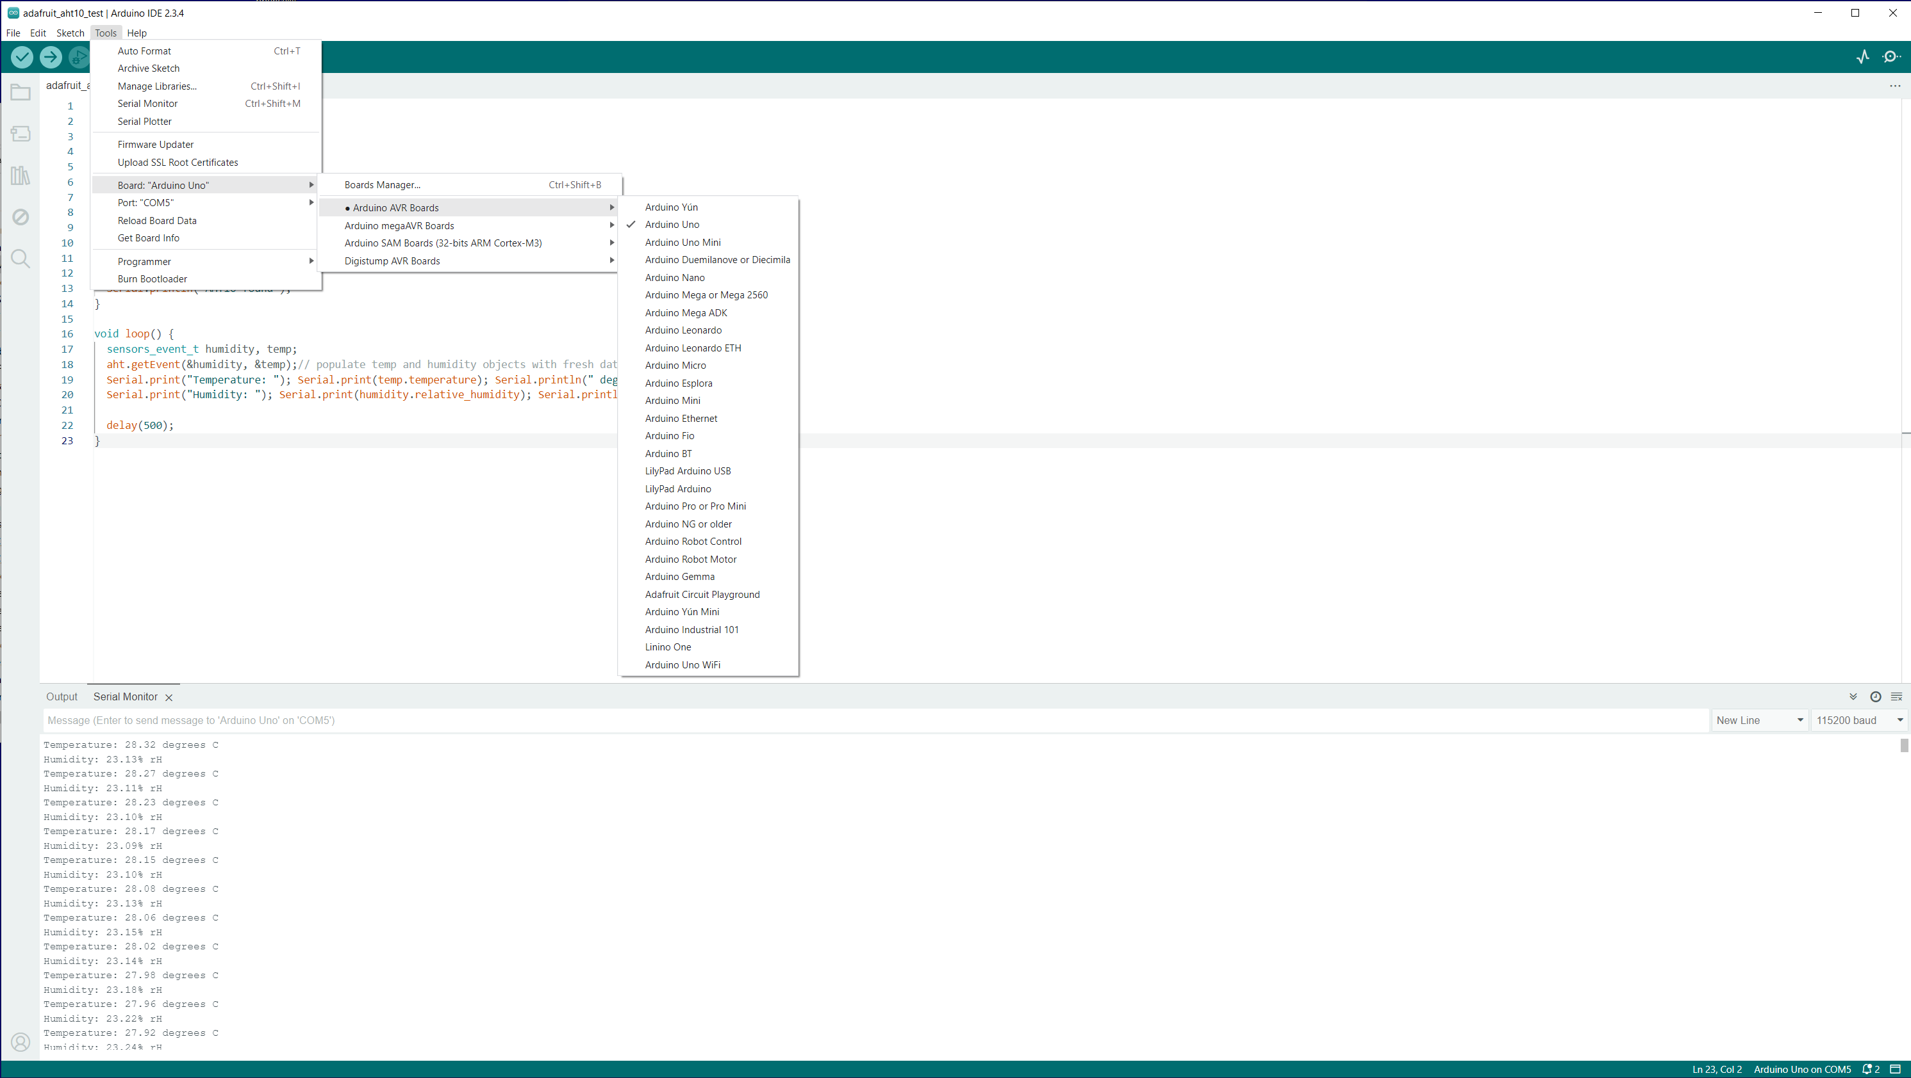
Once the module is wired, select the Arduino board and serial port from the Tools menu.
Next select menu Tools ->
Serial Monitor
And set the speed to 115200 (near lower right of the IDE window)
Lastly, select select menu Sketch ->
Upload
Or click the arrow near the top of the IDE window.
Temperature and Humidity data should begin showing in the serial monitor pane.

Slide 13
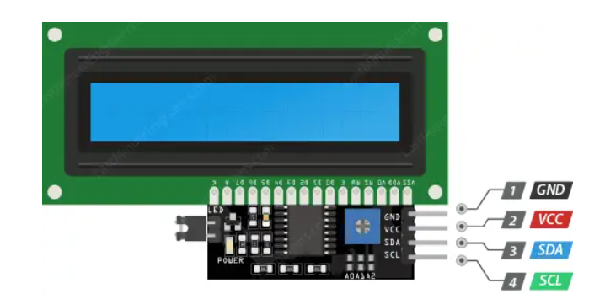
Next, we will add the I2C LCD.
Like the AHT10, the I2C LCD module requires wiring the VCC, GND, SCL and SDA.
(VCC is 5VDC for this module, also)
Wire the I2C and power pins to the Arduino. The trimpot adjusts the LCD contrast, and the jumper enables the LCD backlight.

Slide 14
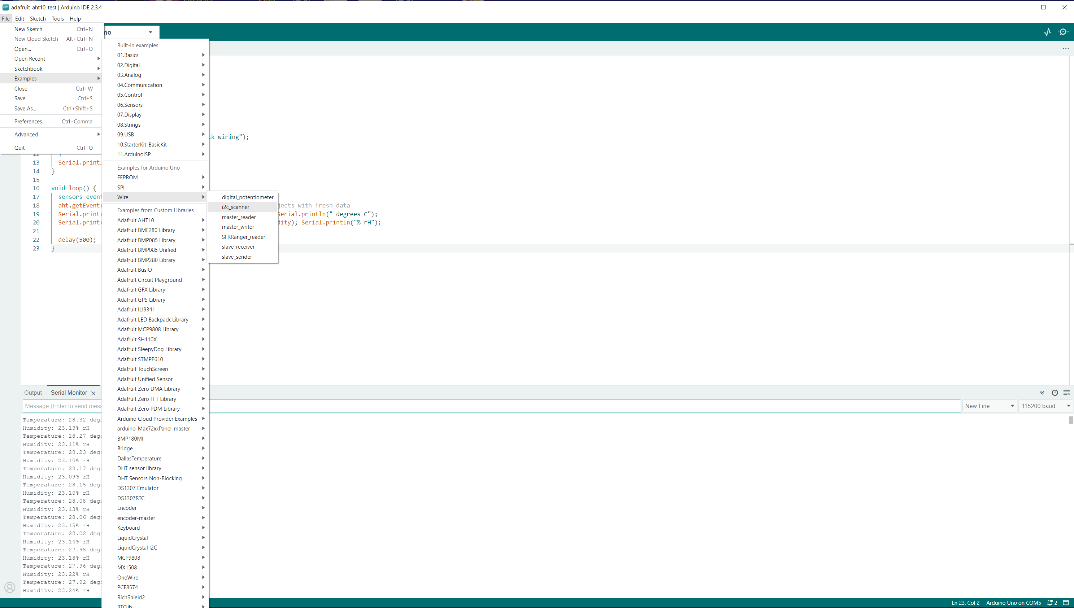
Use of the LCD display requires finding the I2C address of the LCD display (they can vary…)
Select menu File→ Example →
Wire →
I2C scanner
Change the Serial Monitor speed to 9600.
Take note of the address found (mine was 0x27)

Slide 15
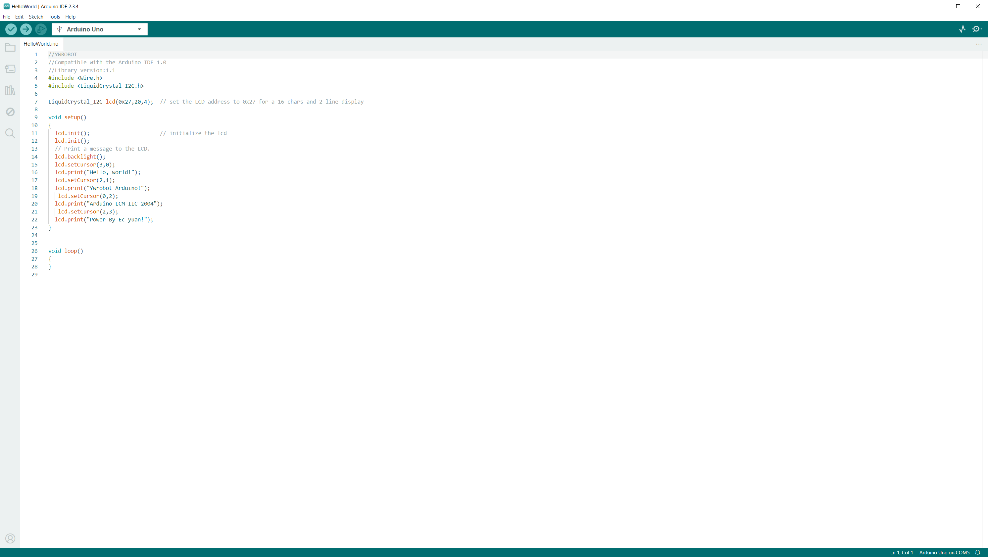
Now to use the the I2C LCD.
Select menu File→ Example →
LiquidCrystal I2C →
Hello World
Change the value in this line
LiquidCrystal_I2C lcd(0x27,16,2);
To the address of your LCD
Do not worry if the characters are odd. This example is for 20x4 LCD. Just be sure there are characters displayed.

Slide 16
//Compatible with the Arduino IDE 1.0
//Library version:1.1
#include <Wire.h>
#include <LiquidCrystal_I2C.h>
LiquidCrystal_I2C lcd(0x27,16,2); // set the LCD address to 0x27 for a 16 chars and 2 line display
void setup()
{
lcd.init(); // initialize the lcd
lcd.init();
// Print a message to the LCD.
lcd.backlight();
lcd.setCursor(3,0);
lcd.print("Hello, world!");
lcd.setCursor(2,1);
lcd.print("Ywrobot Arduino!");
Delay(2000);
lcd.setCursor(0,0);
lcd.print("Arduino LCM IIC 2004");
lcd.setCursor(0,1);
lcd.print("Power By Ec-yuan!");
delay(2000);}
void loop()
{}
Use this sketch and you should get text on the LCD. (the example is for 20 char 4 lines, so it DOES work, but will look odd.
The point is to get text on the LCD.

Slide 17
Now for the payoff.
We will borrow lines from the I2C LCD display example sketch to add the the AHT10 sketch which will write the temperature and humidity to the LCD.

Slide 18
#include <Wire.h>
#include <LiquidCrystal_I2C.h>
LiquidCrystal_I2C lcd(0x27,16,2); // set the LCD address to 0x27 for a 16 chars and 2 line display
lcd.init(); // initialize the lcd
lcd.init();
// Print a message to the LCD.
lcd.backlight();
lcd.setCursor(3,0);
lcd.print("Hello, world!");
lcd.setCursor(2,1);
lcd.print("Ywrobot Arduino!");
These are the important lines to be added and tweaked.

Slide 19
lcd.setCursor(3,0);
lcd.print("Hello, world!");
Take note of these 2 lines of code.
The lcd_setCursor(3,0);
places the starting position of printing on the display to character position 3 on line 1.
lcd.setCursor(<start_position>,<start_line-1>);
Remember that most times, software folk start counting at 0...
The the lcd.print prints that text beginning at the starting position.

Slide 20
#include <Adafruit_AHT10.h>
#include <Wire.h>
#include <LiquidCrystal_I2C.h>
Adafruit_AHT10 aht;
LiquidCrystal_I2C lcd(0x27,16,2); // set the LCD address to 0x27for a 16 char/2 line display
void setup()
{
Serial.begin(115200);
Serial.println("Adafruit AHT10 demo!");
if (! aht.begin())
{
Serial.println("Could not find AHT10? Check wiring");
while (1) delay(10);
}
Serial.println("AHT10 found");
lcd.init(); // initialize the lcd
lcd.init();
// Print a message to the LCD.
lcd.backlight();
}
This is the final result. Let’s look in detail at the code and the lcd.print messages on the next slide

Slide 21
void loop()
{
sensors_event_t humidity, temp;
aht.getEvent(&humidity, &temp);
// populate temp and humidity objects with fresh data
Serial.print("Temperature: "); Serial.print(temp.temperature); Serial.println(" degrees C");
lcd.setCursor(0,0);
lcd.print("Temp "); lcd.print(temp.temperature); lcd.println(" deg C ");
lcd.setCursor(0,1);
Serial.print("Humidity: "); Serial.print(humidity.relative_humidity); Serial.println("% rH");
lcd.print("Hum "); lcd.print(humidity.relative_humidity); lcd.println("% rH ");
Delay(2500);
}

Slide 22
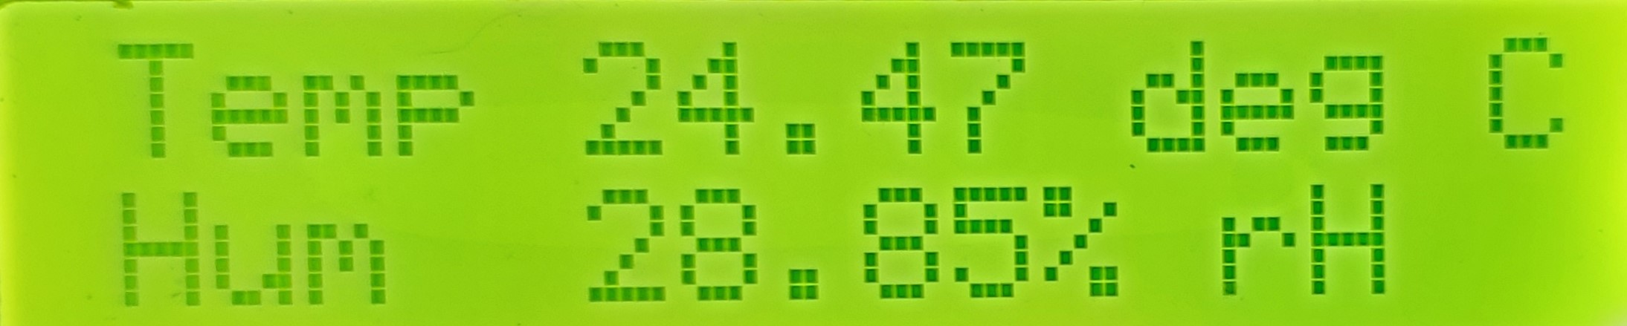
Here is the LCD output from the above sketch

Slide 23
Thanks for your interest

